Slide 1



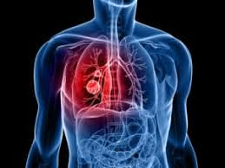

EARLY STAGE LUNG CANCER PREDICTION USING VARIOUS MACHINE LEARNING TECHNIQUES
REAL TIME RESEARCH PROJECT TITLE :
PROJECT BY
DANIYA FATIMA (22U61A6706)
DHANUNJAYA NAIDU (22U61A6726)
DHANUSH KUMAR (22U61A6734)
GUIDED BY
INTERNAL GUIDE : DR. SARA ALI
HEAD OF THE DEPARMENT: MRS. NOORE ILLAHI

Slide 2

ABSTRACT
For more than a decade, machine learning techniques have been applied in cancer research.
Though numerous algorithms for LC prediction are employed in the fields of neurology, radiology, and cancer . MLA excels them due to its accuracy and efficiency.
The approaches involve input data selection, data preparation, feature selection and extraction, and training and testing data and selecting the best ml technique. Secondly, a survey report of the ML algorithms employed in LC is offered, along with their methodology.
The performance metrics such as Accuracy, Sensitivity, Specificity, Precision, F1 Score, Root Mean Square Error (RMSE), Confusion Matrix, Area Under the Curve (AUC) – Receiver Operating Characteristics (ROC) curve, Precision-Recall (PR) curve with various MLa are investigated.
This study also covers the parameters used in constructing an efficient and accurate ML model for the early prediction of LC.

Slide 3
INTRODUCTION
Lung cancer is one of the deadliest cancers worldwide. However, the early detection of lung cancer significantly improves survival rate.
Currently an approximate of 2.09 million cases observed against lung cancer.
Lung cancer is mainly triggered by cigarette smoke. Smoke that penetrates into the lungs causes damage to the lung tissue. In nonsmokers, lung cancer may be induced by radon radiation, second hand smoking, air contamination or other causes. Heredity is another source of lung cancer, as well.
While lung cancer is hard to diagnose and cure, it may be avoided or treated in the early stages, also depending on the stages of the cancer they assign grades to the cancer.
By utilizing machine learning for early stage lung cancer prediction aids in timely diagnosis and patient care.

Slide 4
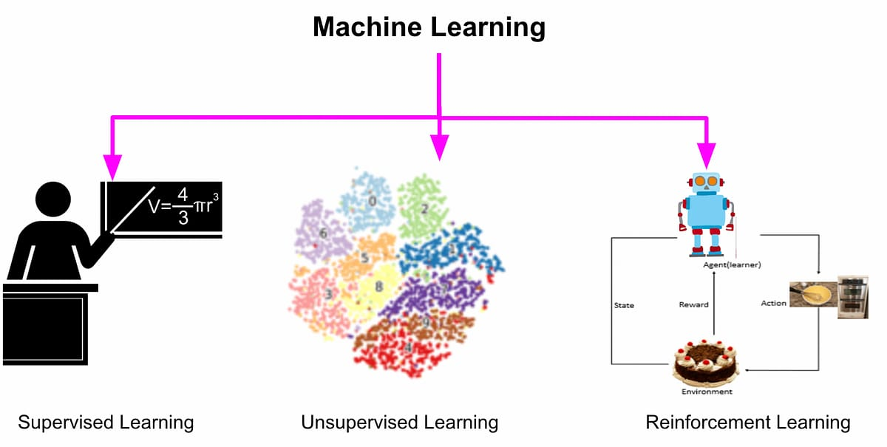
EXISTING SYSTEM
Machine learning techniques handle the data and find the right model.
The main category of ML methods is supervised learning (SL), unsupervised learning (USL), and reinforcement learning (RL).
All SL is a form of classification or Regression.
USL is valuable when the information is uncertain but it needs to be investigated.
RL can be model-free or model-based reinforcement learning.

Slide 5

EXISTING SYSTEM
Disadvantages :
Less amount of accuracy score.
Small level data-set.
Applicable on small level prediction work.

Slide 6

PROPOSED SYSTEM
To construct an efficient and accurate ML model for early LC, the model can be developed with the following parameters.
Data should be collected from large and highly qualified authorized centers.
Data collected should be preprocessed by a powerful technique such that no important data is lost.
Highly correlated Features with the output should be identified for best results.
Using the Hybrid ML model, early prediction of LC can produce accurate results.
Several ML tools and various platforms can be made available for researchers to provide good results.
There are also many data analytical tool that can provide useful information for future data analysis.

Slide 7
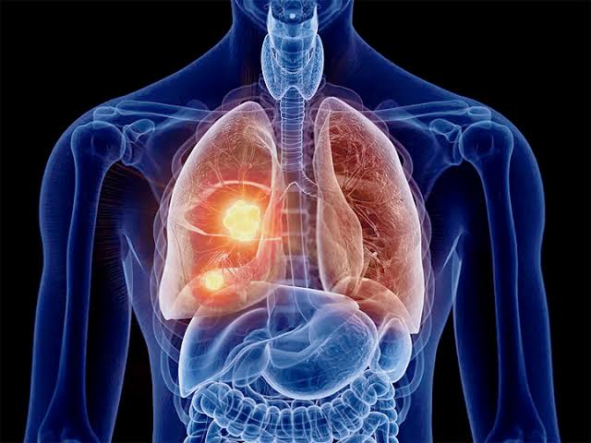
PROPOSED SYSTEM
Advantages :
Increasing the accuracy score.
Large amount of feature we are taking for the training and testing .

Slide 8
SYSTEM REQUIREMENTS
HARDWARE REQUIREMENTS | SOFTWARE REQUIREMENTS | PYTHON PACKAGES
Operating System- Windows 7,8 and10(32 & 64 bit) | Python Language | Numpy
RAM – 4GB | Anaconda Navigator | Pandas
--- | Jupyter Notebook | Matplotlib
--- | --- | Seaborn
--- | --- | Sklearn

Slide 9

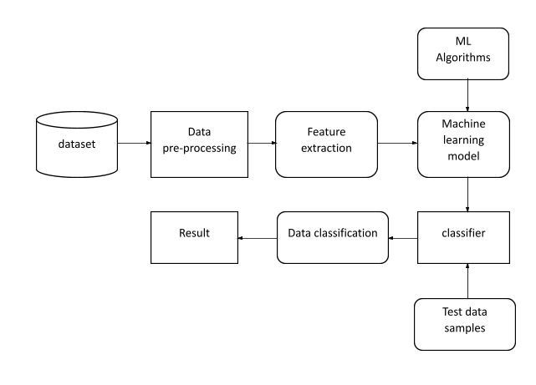



SYSTEM ARCHITECTURE

Slide 10
TESTING:
Software testing is an investigation conducted to provide stakeholders with information about the quality of the product or service under test.
TESTING METHODS
Functional Testing
Functional tests provide systematic demonstrations that functions tested are available as specified by the business and technical requirements, system documentation, and user manuals.
Integration Testing
Software integration testing is the incremental integration testing of two or more integrated software components on a single platform to produce failures caused by interface defects.

Slide 11
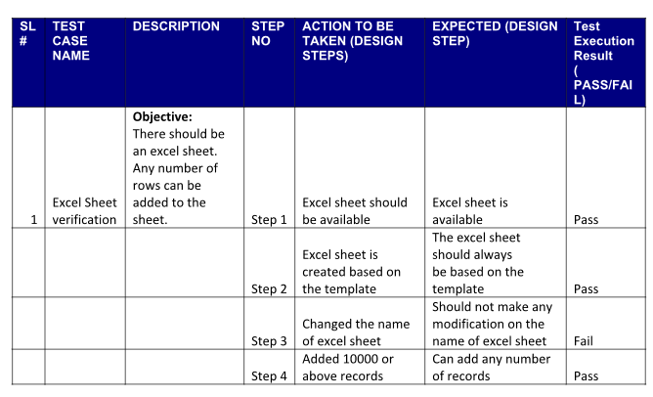
TESTING:
Test Case for Excel Sheet Verification:
Here in machine learning we are dealing with dataset which is in excel sheet format so if any test case we need means we need to check excel file. Later on classification will work on the respective columns of dataset .
Test Case 1 :

Slide 12

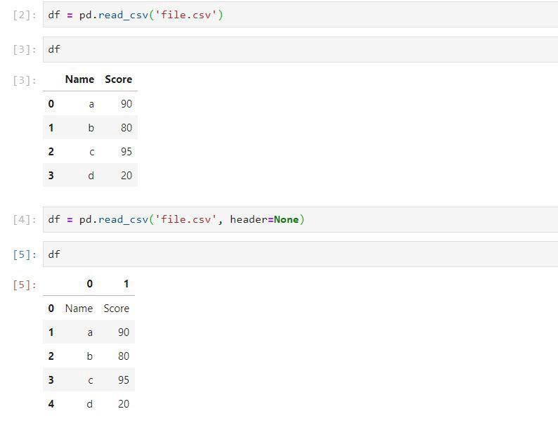
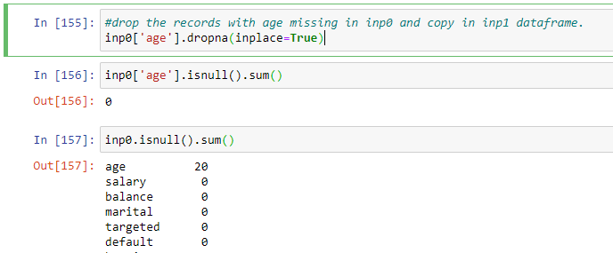
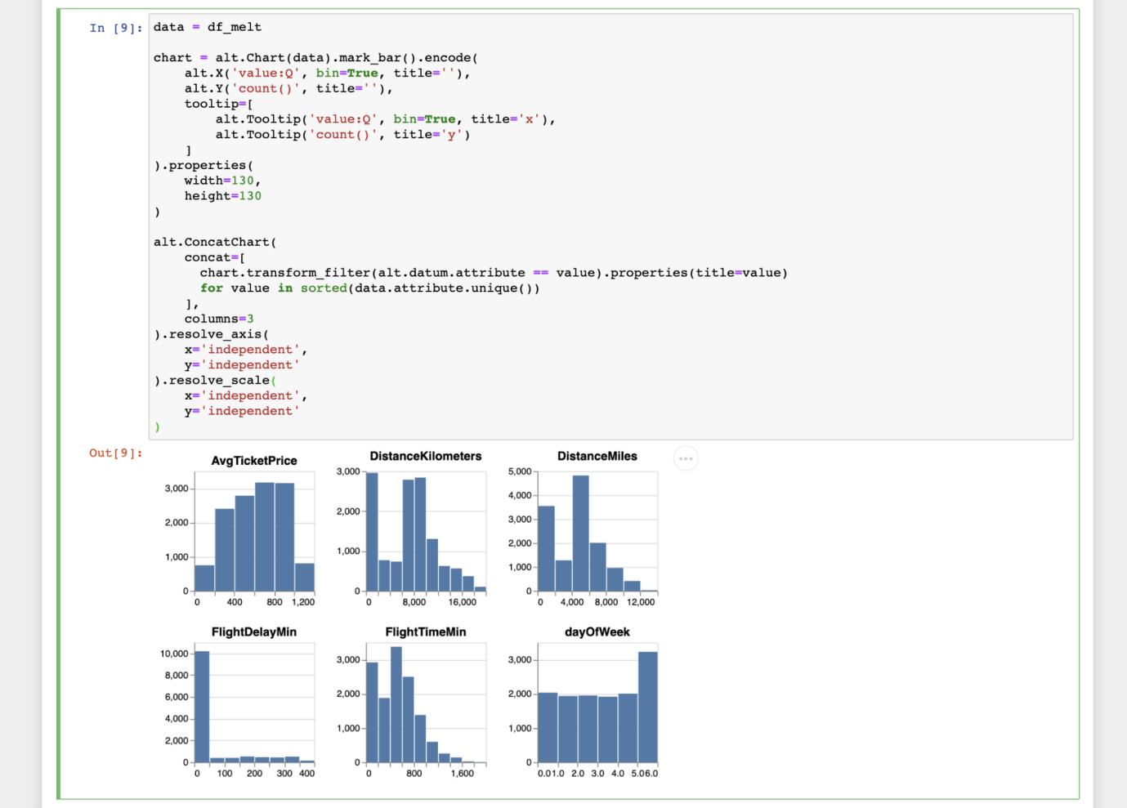
RESULT :
Importing packages
Data Collection
Data preprocessing
Feature Extraction

Slide 13
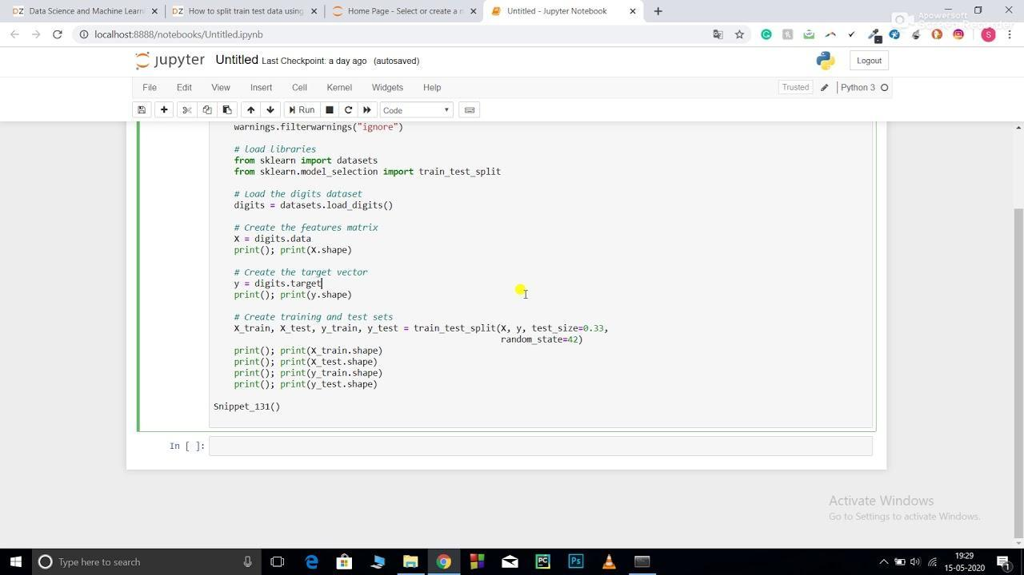
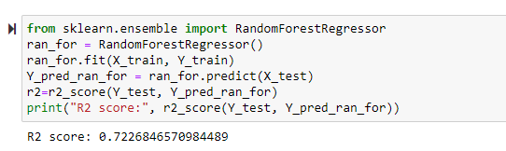
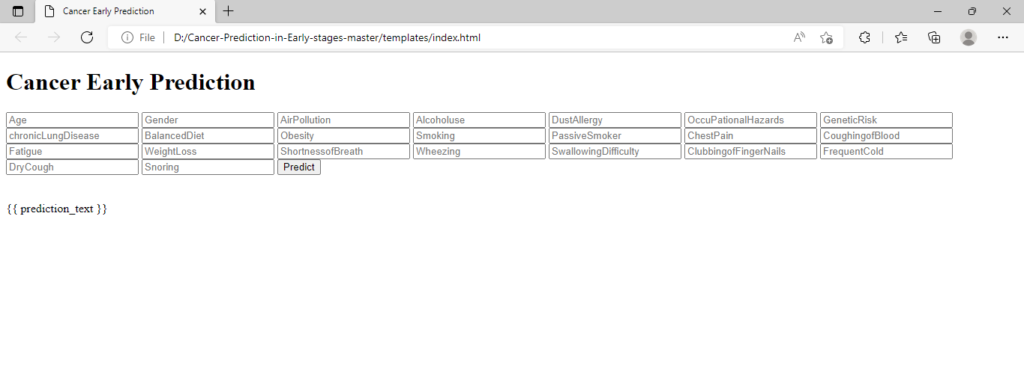
RESULT :
Training and Testing
Evaluation model
Web page

Slide 14
RESULT :
The experiment is carried to predict the best fitting model for lung cancer patient data set which gives the greatest accuracy.
The aim of conducting the experiment is to predict the early stage lung cancer in a person utilizing the various machine learning classification algorithms.
During the course of the project the research on various papers helped in learning various aspects of the project.
The study helped in understanding that SVM is not suitable for data having more noise along with large data sets. Also it is understood that with a large number of trees, the random forest algorithm becomes slow for real time prophecy and it acts as a predictive model like a black box.
The study gives an idea about how K-NN works well only with balanced data and is sensitive to outliers. Furthermore, the working of artificial neural networks with numerical data makes it difficult to show the problem to the network and the network duration is unknown.
This also helped in the consideration of techniques and features based on various factors.

Slide 15

CONCLUSION :
The experiment helped in learning various machine learning algorithms, its implementation, uses, pros and cons.
It also gave a complete insight on preprocessing techniques and numerous activation functions used in neural networks.
Building various models, training and testing them tells that the voting classifier is the best suitable model on this dataset for the early stage prediction of lung cancer in a patient.

Slide 16
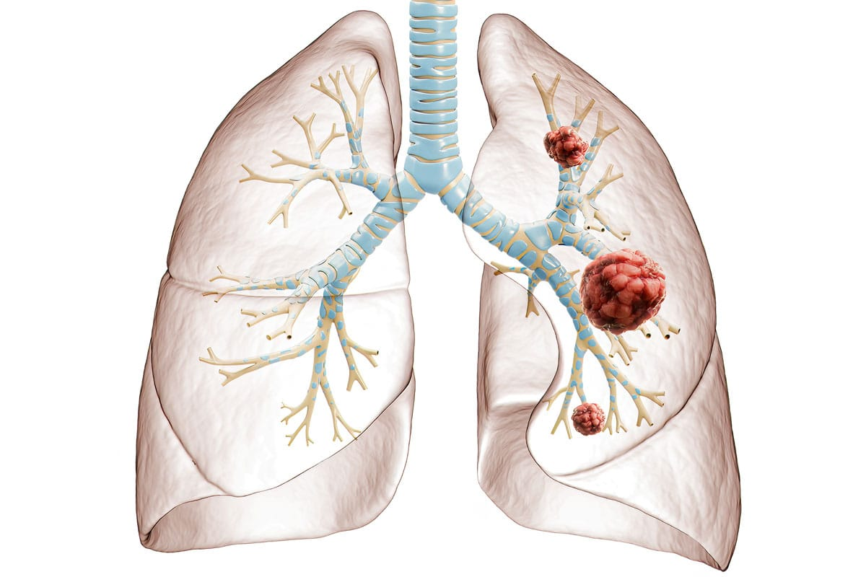
FUTURE SCOPE :
There is a scope of enhancement in the experiment by using various other models like Logistic Regression, Extra trees classifier and boosting methods.
The accuracy might vary depending on the volume of the data collected by applying various other preprocessing techniques and tools which can be explored further.

Slide 17
THANK YOU !!
ANY QUESTION ??

